Slide 1
AJAX and PHP
XHTML, Javascript, AJAX, PHP

Slide 2
AJAX SERVER??
No such thing!
Server-side applications just need to serve data
using HTTP
Clients using AJAX framework can communicate
with any type of server applications
PHP script
Java servlet
JSP
etc.

Slide 3
Client-Side Programming

Slide 4
Client-Side Programming
Recall the technologies comprising DHTML
HTML (content)
Document Object Model (DOM) (data structure)
JavaScript (behaviour)
Cascading Style Sheets (presentation)
JavaScript is a powerful tool for dynamic client-side programming
But what if we wanted to frequently communicate with the server?

Slide 5
Recall: Incorporating Java Script
Handling browsers that do not support Javascript
<html>
<body>
<script type="text/javascript">
<!--
document.write("Hello World!");
//-->
</script>
<noscript>
<h2>Your Browser doesn’t support JavaScript! </h2>
</noscript>
</body>
</html>
use HTML comments so that browsers that do not support JavaScript do not display your code

Slide 6
Client-Server Communication

Slide 7
Client-Server Communication
JavaScript runs inside a sandbox attached to the browser
Sequence of steps:
JavaScript code uses DOM to build HTML document.
GET/POST string is formed.
Browser encodes HTML and GET/POST queries into an HTTP string.
Browser establishes contact with server and sends the HTTP request.
Browser receives HTTP response from the server and displays the body of the page.
It would be nice if one could write JavaScript code that can directly communicate with the server

Slide 8
How does AJAX work?
AJAX uses a programming model with display and events.
These events are user actions, they call functions associated with elements of the web page.
Interactivity is achieved with forms and buttons.
DOM allows to link elements of the page with actions and also to extract data from XML or Text files provided by the server.

Slide 9
How does AJAX work?
Browser
Internet
An event occurs...
Create an
XMLHttpRequest object
Server
Send
XMLHttpRequest
Process
HttpRequest
Create a response and send data back to the browser
Browser
Wait until document has finished loading
Process the returned data using Javascript
Internet
Update page content

Slide 10
How does AJAX work?
To get data on the server, XMLHttpRequest provides two methods:
open: create a connection.
send: send a request to the server.
Data furnished by the server will be found in the attributes of the XMLHttpRequest object:
responseXml for an XML file or
responseText for a plain text.

Slide 11
XMLHttpRequest object
readyState | The value ranges from 0 to 4, 4 means "ready".
status | 200 means OK 404 if the page is not found.
responseText | holds loaded data as a string of characters.
responseXml | holds an XML loaded file, DOM's method allows to extract data.
onreadystatechange | property that takes a function as value that is invoked when the readystatechange event is dispatched.
These are the properties of an XMLHttpRequest object that we are going to utilise to retrieve a response from the server.
http://www.xul.fr/en-xml-ajax.html

Slide 12
PHP-MySQL-AJAX
Example #1
Files
MySQL database (*.sql)
PHP script (*.php)
HTML document (*.htm)
Javascript (*.js)
Communicates with the MySQL server to retrieve records based on a user’s query

Slide 13
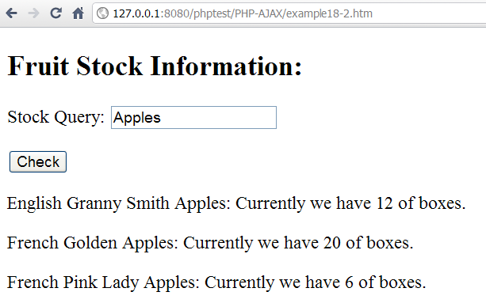
Database Stock Example
Contains the user’s query
PHP script
output
AJAX can be used to run PHP scripts that obtain up-to-the-minute information stored on a database.
The database is queried when the user interacts with the application, delivering accurate information without the inconvenience of a page reload.

Slide 14
HTML Document

Slide 15
Database Stock Example
<!DOCTYPE html PUBLIC "-//W3C//DTD XHTML 1.1//EN"
"http://www.w3.org/TR/xhtml11/DTD/xhtml11.dtd">
<html xmlns="http://www.w3.org/1999/xhtml" xml:lang="en">
<head>
<title>Stock Script</title>
<meta http-equiv="Content-Type" content="text/html; charset=ISO-8859-1" />
<script type="text/javascript" src="getxmlhttprequest.js">
</script>
<script type="text/javascript" src="example18-2.js">
</script>
</head>
...
example18-2.htm
We have two Javascript files in our example. They are loaded in the <head> section of our HTML file.

Slide 16
Database Stock Example
<body>
<h2>Fruit Stock Information:</h2>
<form action="" method="post">
<p>
<label for="strStock">Stock Query: </label>
<input type="text" name="strStock" id="strStock"/>
</p>
<p>
<input type="button" value="Check" onclick="startJS();"/>
</p>
…
example18-2.htm (continuation…)
We have a query input text field and a submit button
The submit button includes an onclick event which invokes the startJS() function when clicked (example18-2.js).

Slide 17
Database Stock Example
<body>
<h2>Fruit Stock Information:</h2>
<form action="" method="post">
<p>
<label for="strStock">Stock Query: </label>
<input type="text" name="strStock" id="strStock"/>
</p>
<p>
<input type="button" value="Check" onclick="startJS();"/>
</p>
<div id="strStockResult"></div>
</form>
</body>
</html>
example18-2.htm (continuation…)
The <div> element defines a section used to display the output from the PHP script.

